Slide 1
Kickstarter
Predicting campaign success on
Natasha Borders
Notes:
Good afternoon, I’m Natasha and today we’re going to talk about Kickstarter and what factors affect the success of a campaign.

Slide 2
How does Kickstarter work?
All or nothing funding model
Creators want the campaign to succeed
Backers don’t want to miss an amazing opportunity
Kickstarter profits from managing both sets of expectations
Notes:
Let’s begin by examining how Kickstarter works.
The campaigns are based on all or nothing funding model, which means that if the campaign fails, no money changes hands.
The cost of failure lies heavier on the creators.
While it is also important for the backers to pick a successful campaign, and not miss out, I’m going to lean into the needs of the creators for the purposes of this analysis, to help Kickstarter attract more of them and grow the platform.

Slide 3

Campaign Data
Goal in USD
Campaign length in days
Category
Where the project is based
Marked as “Projects We Love”
Length of Description
Dataset obtained from a scraping website and compiled by aggregating monthly data covering April 2018-March 2019
Notes:
The data for this analysis came from a web scraping site which compiles Kickstarter data on an ongoing basis, and I examined the period covering April 2018 through March 2019
The type of information used was the data available when the campaign is launched.

Slide 4
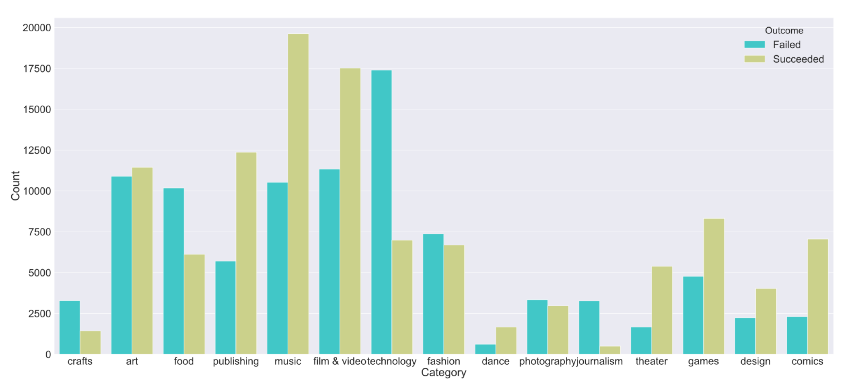
Kickstarter Campaigns
54% succeeded, 46% failed
Notes:
Overall, Kickstarter campaigns span 15 categories ranging from art and crafts to technology, film and video.
Slightly more than half of campaigns within my dataset were successful, so the classes were fairly well balanced.

Slide 5
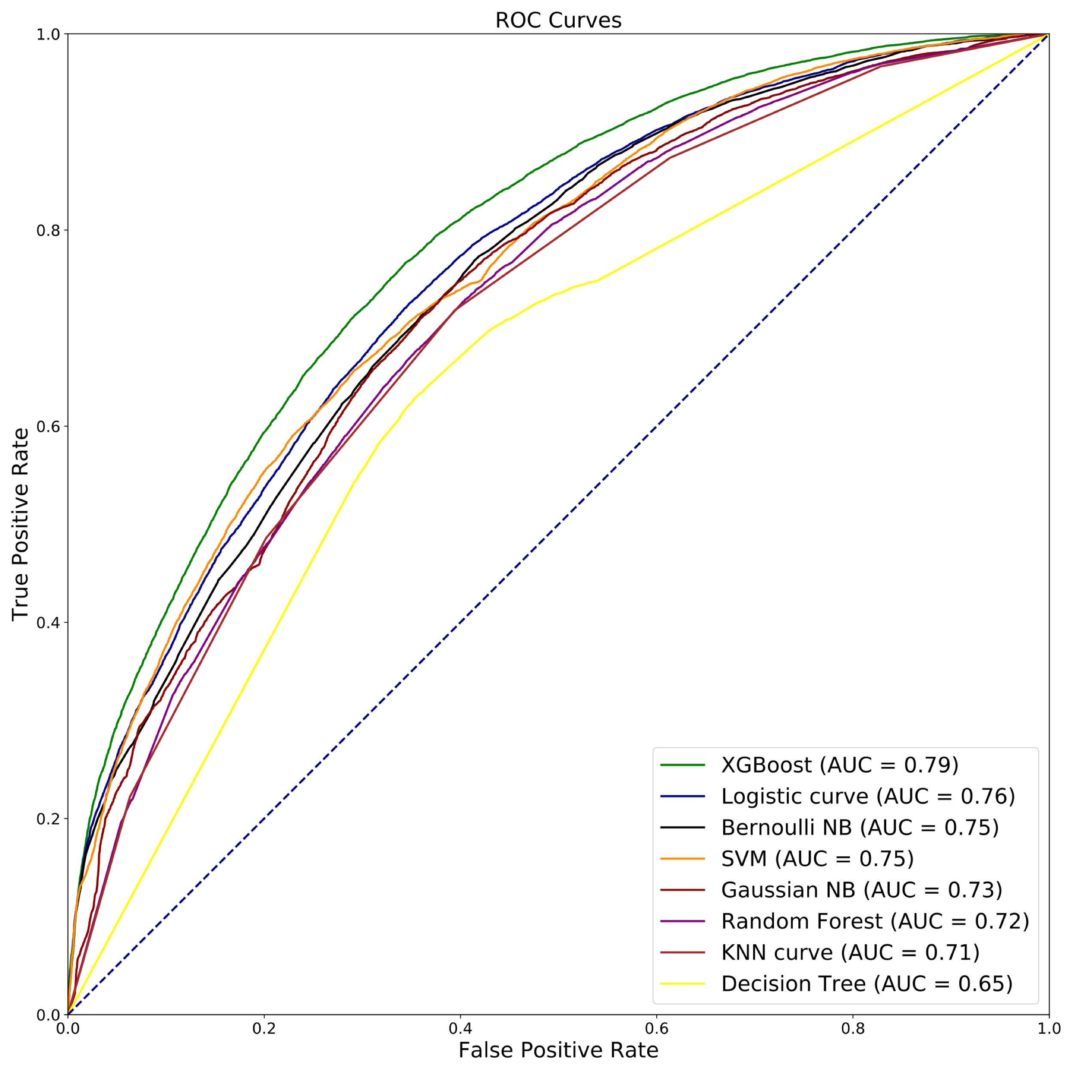
Model Evaluation
‘Success’ Class | Precision
XGBoost | .71
Logistic Regression | .69
Bernoulli NB | .68
SVM | .72
Gaussian NB | .64
Random Forest | .69
KNN | .68
Decision Tree | .67
XGBoost
(AUC = 0.79)
Notes:
As a result of the initial evaluation of several classification algorithms, and based on the ROC curve performance as my main evaluation metric, XGBoost and Logistic Regression were the top performers.
Double checking the precision metric for the SUCCESS class of the campaign, to make sure we are not predicting too many successes which would turn out to be failures, the overall top performer is XGBoost.
####
While SVM performed slightly better on precision, its overall lower performance and excessive run times made it a less desirable candidate for production.

Slide 6
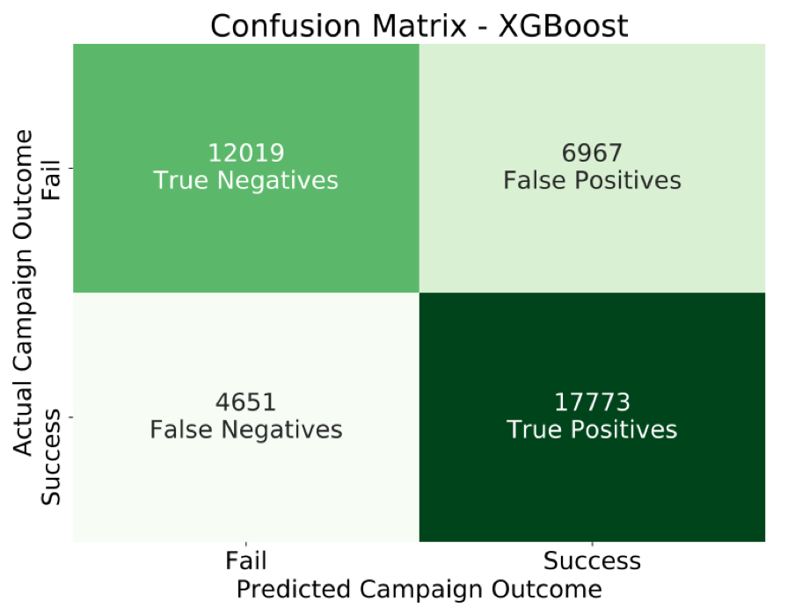
XGBoost Performance on Test Data
 | Validation | Test
AUC | .79 | .79
Precision ‘Success’ Class | .71 | .72
Notes:
After running the , XGBoost, on the test data, it performed consistently, which means there was no overfitting or underfitting in the data. The precision score for the success class increased slightly.

Slide 7
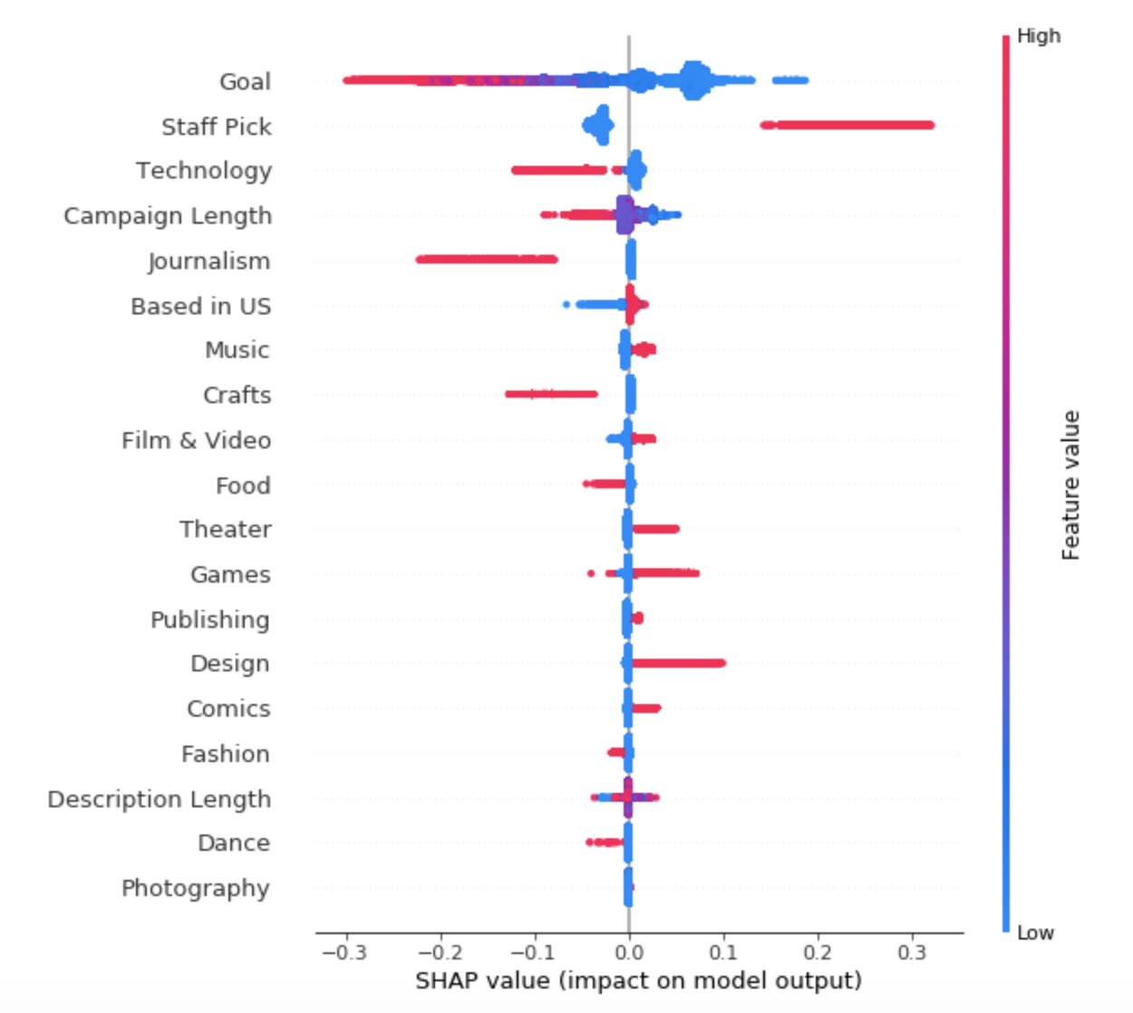
Feature Importance with XGBoost
Setting a low goal benefits the campaign
Shorter campaigns do better
Kickstarter endorsement improves chance of success
Choice of category matters
https://github.com/slundberg/shap
Notes:
Now let’s talk about what makes a successful campaign.
Using a metric called the SHAP values, we can examine which attributes have higher importance for campaign success.
The color indicates the magnitude of the feature, The direction indicates positive or negative impact on the model outcome. The splotchy appearance comes from many data points clustered together at those areas. For example, Having a small goal has positively affected many campaigns, and having large goals has been detrimental to a smaller proportion of campaigns.
The categories are being compared to art so we can conclude that design and games are getting higher traction than art while journalism and crafts appear to be negatively affecting the campaign’s odds of success.
The Shapley value is the average contribution of a feature value to the prediction in different coalitions.
In summary, Shapley values calculate the importance of a feature by comparing what a model predicts with and without the feature. However, since the order in which a model sees features can affect its predictions, this is done in every possible order, so that the features are fairly compared.
To get an overview of which features are most important for a model we can plot the SHAP values of every feature for every sample. The plot below sorts features by the sum of SHAP value magnitudes over all samples, and uses SHAP values to show the distribution of the impacts each feature has on the model output. The color represents the feature value (red high, blue low). This reveals for example that a high LSTAT (% lower status of the population) lowers the predicted home price.
Summarize the impact of all features over the entire dataset
A SHAP value for a feature of a specific prediction represents how much the model prediction changes when we observe that feature. In the summary plot below we plot all the SHAP values for a single feature (such as goldearned) on a row, where the x-axis is the SHAP value (which for this model is in units of log odds of winning). By doing this for all features, we see which features drive the model's prediction a lot (such as goldearned), and which only effect the prediction a little (such as kills). Note that when points don't fit together on the line they pile up vertically to show density. Each dot is also colored by the value of that feature from high to low.

Slide 8
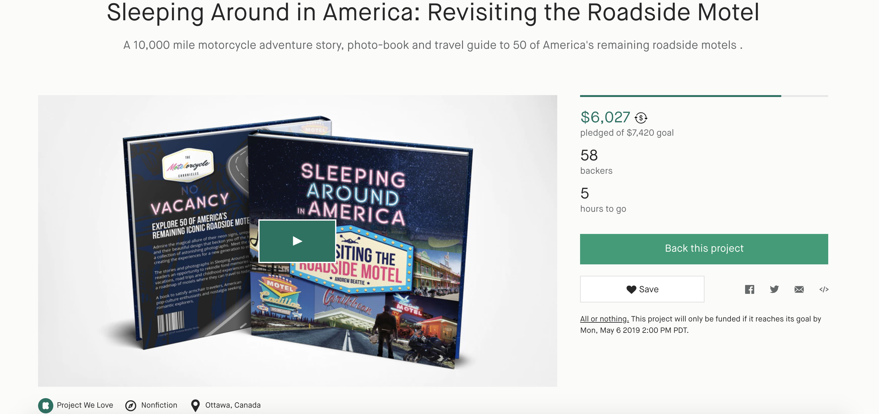
Notes:
To demonstrate this predictive algorithm at work, I developed a Flask app using the logistic regression model, second highest performing algorithm which proved to be easier and faster deployable than XGBoost.
I chose a campaign that was ending in a few hours and predicted it’s outcome.

Slide 9
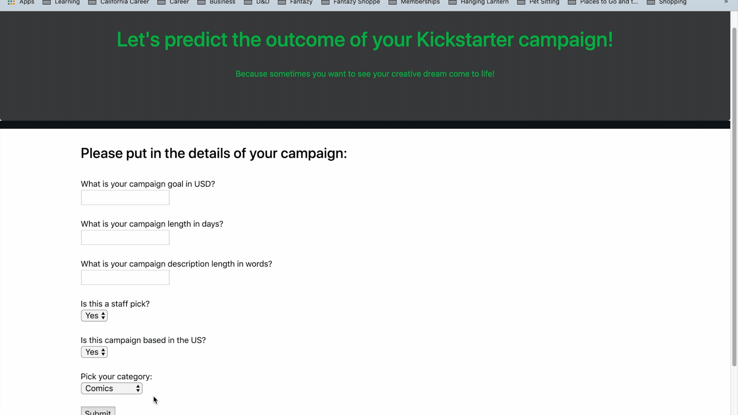

Notes:
To demonstrate this predictive algorithm at work, I developed a Flask app using the logistic regression model, second highest performing algorithm which proved to be easier and faster deployable than XGBoost.
I chose a campaign that was ending in a few hours and predicted it’s outcome.
Five hours later it ended in a success.

Slide 10
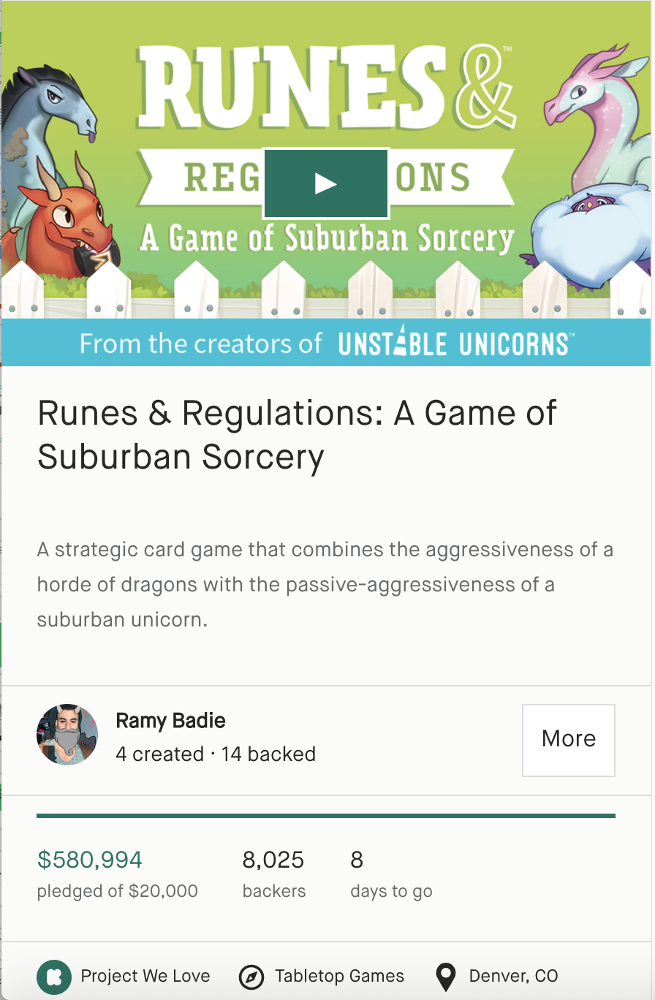
Creator Recommendations
Set a small goal in USD that fits the scope of the campaign
Don’t stretch the campaign past 30 days
Consider the category carefully
Get endorsed by Kickstarter
Notes:
Based on the findings of this analysis, creators are recommended to set a low, achievable goal which will satisfy their requirements,
not stretch their campaign past 30 days, and
to consider the category of their project carefully.

Slide 11
Next Steps
Develop XGBoost Heroku app
1
Explore monetary side of things
2
What will the future bring?
3
Full functionality and visual appeal
Do stretch goals help?
Explore how quickly campaigns are fulfilled
K
Notes:
Going forward, I’d like to develop an Xgboost Heroku app and increase the functionality and visual appeal,
look into how much the successful campaigns raise and if setting stretch goals is beneficial,
and dive into the ongoing challenge of campaign fulfillment and how it can be improved.

Slide 12
Thank you!
Any questions?
Notes:
XGBoost is an optimized distributed gradient boosting library designed to be highly efficient, flexible and portable. It implements machine learning algorithms under the Gradient Boosting framework. XGBoost provides a parallel tree boosting (also known as GBDT, GBM) that solve many data science problems in a fast and accurate way. The same code runs on major distributed environment (Hadoop, SGE, MPI) and can solve problems beyond billions of examples.

Slide 13
Analysis Pipeline
Data Cleaning
Feature Engineering
Grid Search CV
on
top performers
Flask app on
Heroku
Model Selection
AUC and Precision
Performance
evaluation
Notes:
I began by organizing the campaign data and extracting the features discussed in the previous slide. After analyzing the data using 8 different classification algorithms, I used the overall quality metric of an area under the curve, and then finetuned the top performing models by using the grid search. The top model was then evaluated on the test data. Finally I made a Flask app to demo the model.

Slide 14
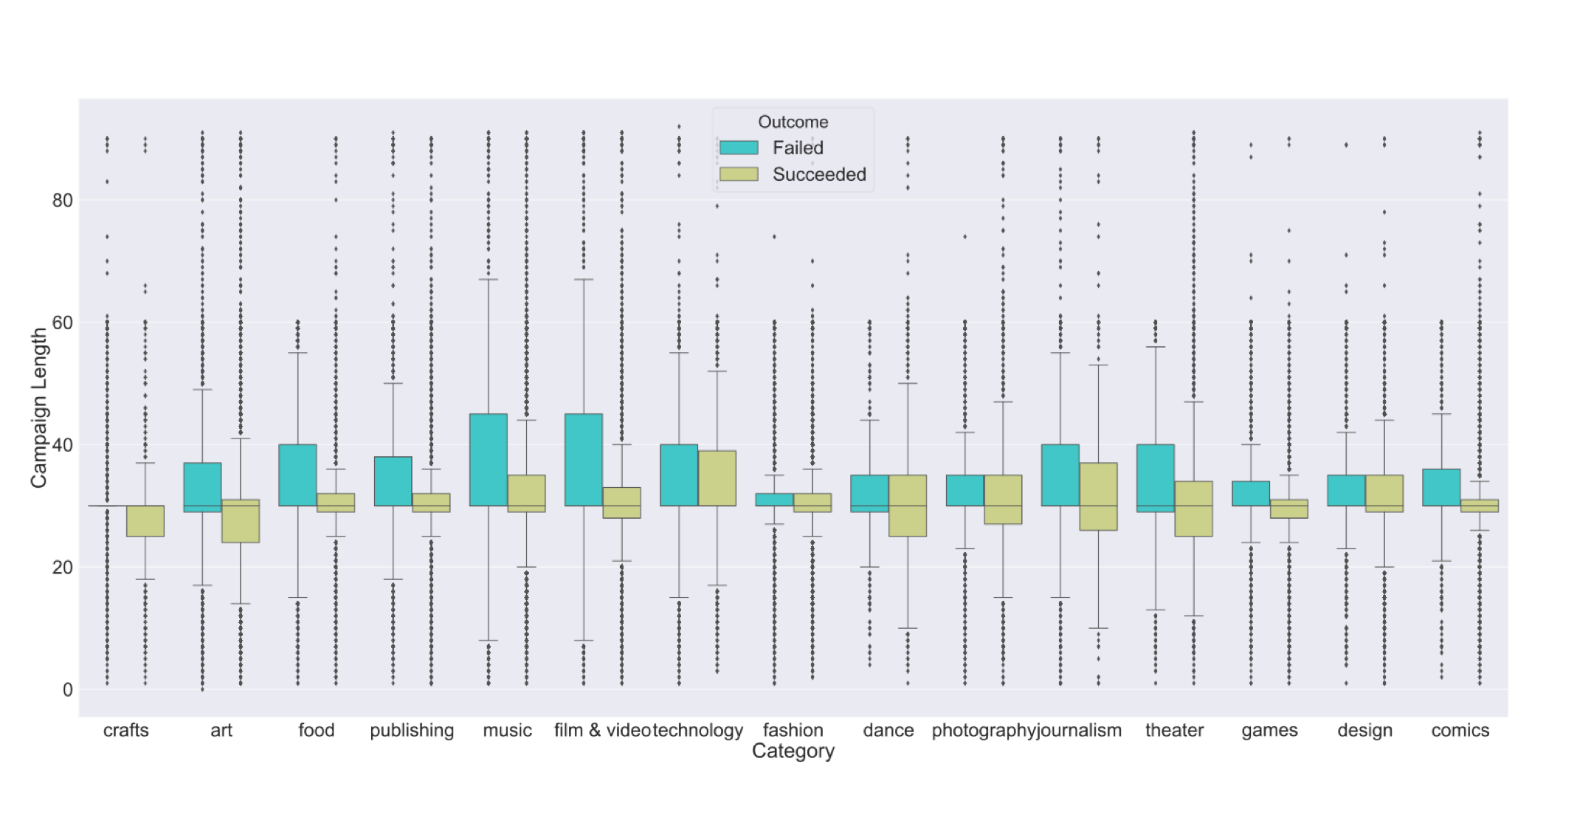

Slide 15
